Slide 1

Smart Odometer Powered by Blockchain
A Final Presentation
On
Project (KIT - 851)
Presented by
Imran Hashimi (2007360130024)
Pratiksha Bharti (2007360130043)
Sanandan Kumar (2007360130049)
Sarvesh Gond (2007360130051)
Under the guidance of
Dr. Tauseef Ahmad
Assistant Professor
Department of Information Technology
Rajkiya Engineering College, Azamgarh

Slide 2
TABLE OF CONTENTS
6
Introduction
Objective
Literature Review
Problem Formulation
Proposed Methods Of Solution
Technology Used
Result
Use Case/Applications
Conclusion
References

Slide 3
INTRODUCTION
6
A smart odometer is a device used to measure distance travelled by a vehicles such as cars or bikes.
Our project integrates the traditional function of an odometer with the security, transparency, and decentralized nature of blockchain.
By utilizing blockchain, the smart odometer ensures that all recorded mileage data is secure, unchangeable, and easily verifiable by relevant stakeholders.

Slide 4
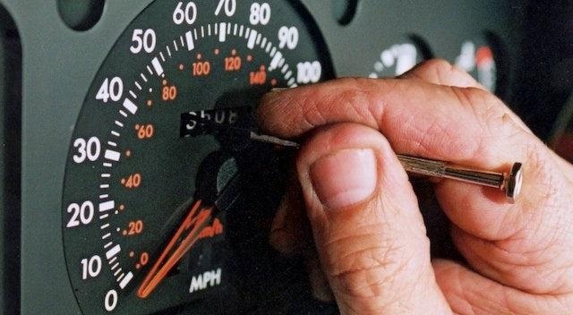
OBJECTIVE
6
We are creating a tamper-proof system for recording vehicle mileage on a blockchain, ensuring data security and authenticity.
We will solve the problem of traditional odometer by utilizing the power & algorithm of blockchain.
We’re tackling this fraud by implementing transparency and immutable records using the decentralized database.
Fig 1: Mechanic tampering traditional odometer.

Slide 5
LITERATURE REVIEW
6
Ref No | Year | Title of the Paper | Concept Theoretical Model | Research Gap
[1] | 2023 | Blockchain Based used Vehicle Tracking System | This paper describes an Android app integrates blockchain, API, and smart contracts to securely store unalterable vehicle information, ensuring transparency, trust, and reliability in the used-car market. | Blockchain use is limited, lacking unalterable storage. It focuses on authentication and user details, neglecting km reading records, hindering comprehensive and secure information storage.
[2] | 2021 | A Blockchain-Based Vehicle Condition Recording System for Second-Hand Vehicle Market | The proposed blockchain-based system on Ethereum provides a trusted vehicle data source, empowering third parties to record and maintain vehicle information, ensuring transparency and preventing data tampering | The active second-hand vehicle market lacks transparency and faces authenticity issues. Blockchain technology offers a solution, ensuring trustworthy vehicle data and preventing misinformation.

Slide 6
LITERATURE REVIEW (continued…)
6
Ref No | Year | Title of the Paper | Concept Theoretical Model | Research Gap
[3] | 2020 | Blockchain Applied to Vehicular Odometers. | The theoretical model involves a blockchain for vehicular odometers, leveraging distributed ledger technology and a novel consensus algorithm to ensure secure, immutable, and efficient registration of odometer data, combating fraud. | The research gap lies in the lack of efficient and scalable blockchain solutions addressing vehicular odometer fraud. Existing literature lacks a comprehensive model with a focus on consensus algorithms in real-world scenarios.
[4] | 2020 | Securing car data and analytics using blockchain. | Utilizing blockchain for secure, transparent, and efficient transactions in the Mauritian automotive industry, focusing on vehicle importation and sales. | Lack of detailed exploration on scalability, real-world adoption challenges, and potential limitations implementing blockchain for vehicle use cases.

Slide 7
LITERATURE REVIEW (continued…)
6
Ref No | Year | Title of the Paper | Concept Theoretical Model | Research Gap
[5] | 2020 | Trusted Systems of Records Based on Blockchain Technology - A Prototype for Mileage Storing in the Automotive Industry | Utilizing blockchain and IoT to securely collect and log rich telemetric data from connected cars, ensuring transparency and trust in the automobile industry for stakeholders. | Insufficient exploration of Alternative deployments Blockchain and their suitability for securely storing and managing telemetric data in the automotive industry.
[6] | 2019 | Blockchain Technology Applied in Electric Vehicle Power Trading System. | The core idea is to create a decentralized and immutable system for recording and verifying crucial data, particularly vehicle mileage, to reduce fraud and enhance transparency. | The paper discusses the prevalence and economic costs of mileage manipulation in the used car market but does not extensively dive into the technical current approaches to detect and prevent this fraud.

Slide 8
PROBLEM FORMULATION
6
Traditional odometers can be easily tampered or altered.
Incorrect mileage readings can affect fair vehicle pricing.
Uncertain mileage records impact overall confidence in the industry.
Traditional Odometer lacks integrity & transparency of km readings.
Consumers lose trust in the auto industry due to unclear and unreliable mileage records.

Slide 9
PROPOSED METHODS OF SOLUTION
6
Data Collection from odometer (Manually).
Verification & Storage of Data
Blockchain Integration
Smart contract for odometer data
Deployment of Smart Contract
Integration of Smart Contract with Front-End & Back-End.
Scalability and Performance Optimization

Slide 10


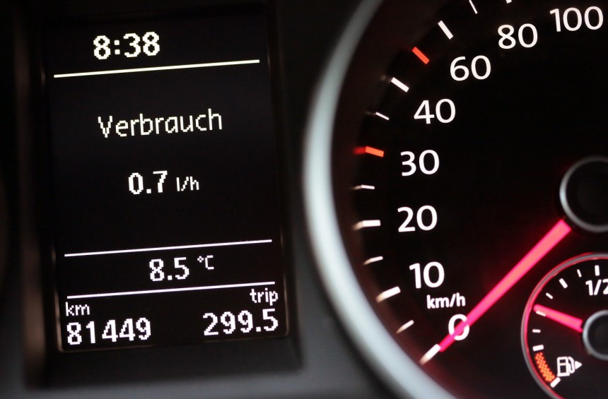

PROPOSED METHODS OF SOLUTION
Hash into blockchain
Hash (Odometer l | Date l | Nonce1)
Hash (Odometer 2 | Date2 | Nonce2)
Hash (Odometer 3 | Date3 | Nonce3)
Ethereum
blockchain
Transaction signing
Raw data encryption
User interface (web app)
Successful verification
Data
Application
Hash (Odometer l | Date l | Nonce 1)
Hash (Odometer 2 | Date2 | Nonce2)
Hash (Odometer 3 | Date3 | Nonce3)
Smart odometer
Encrypted raw data into
Secure private storage
MongoDB
Fig 2: Architecture of Prototype

Slide 11


Technology Used:
Fig 3: Front-End
Fig 4: Back-End

Slide 12



Technology Used (continued…):
Fig 5: Ganache
Fig 6: Truffle
Fig 7: Meta Mask

Slide 13
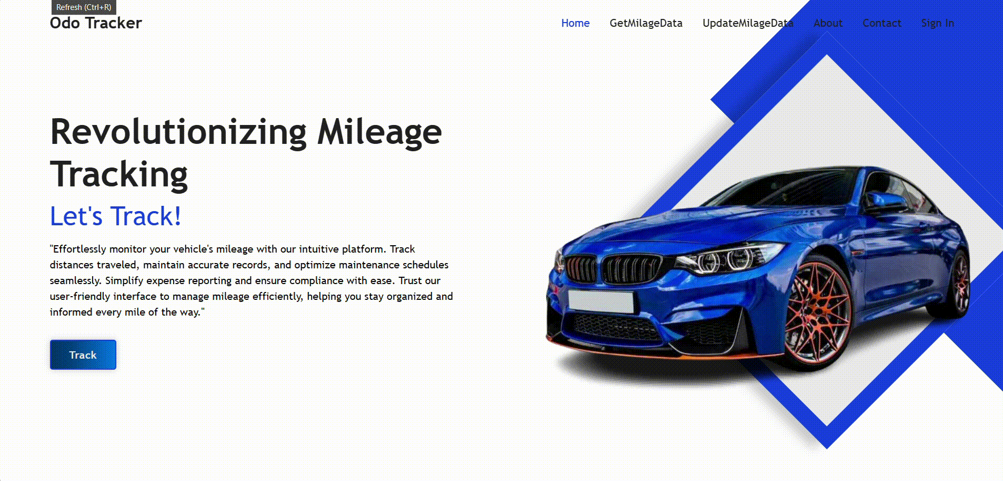
RESULT
6
Fig 9: Overview of the result

Slide 14
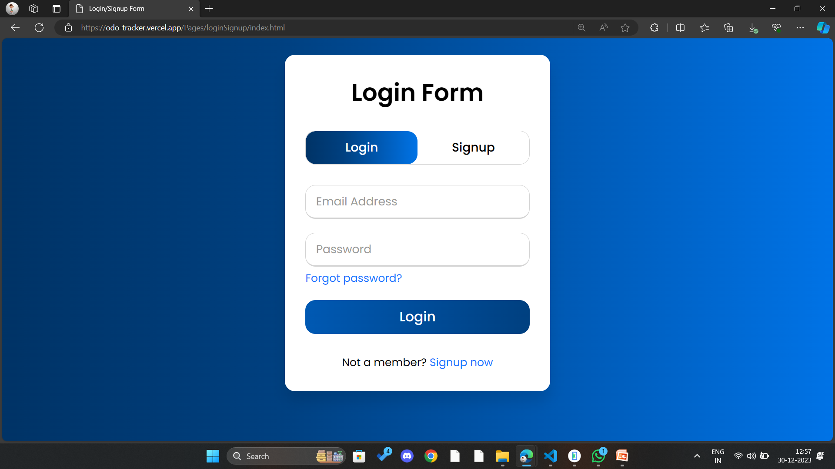
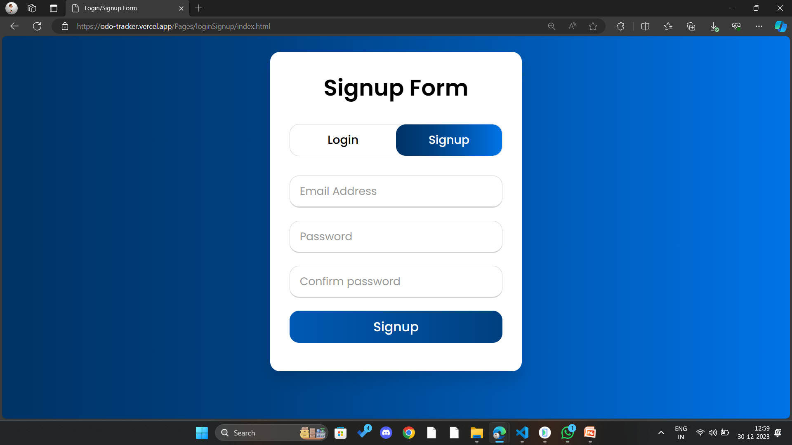
RESULT (continued…)
6
Fig 10: Login Page
Fig 11: Signup Page

Slide 15
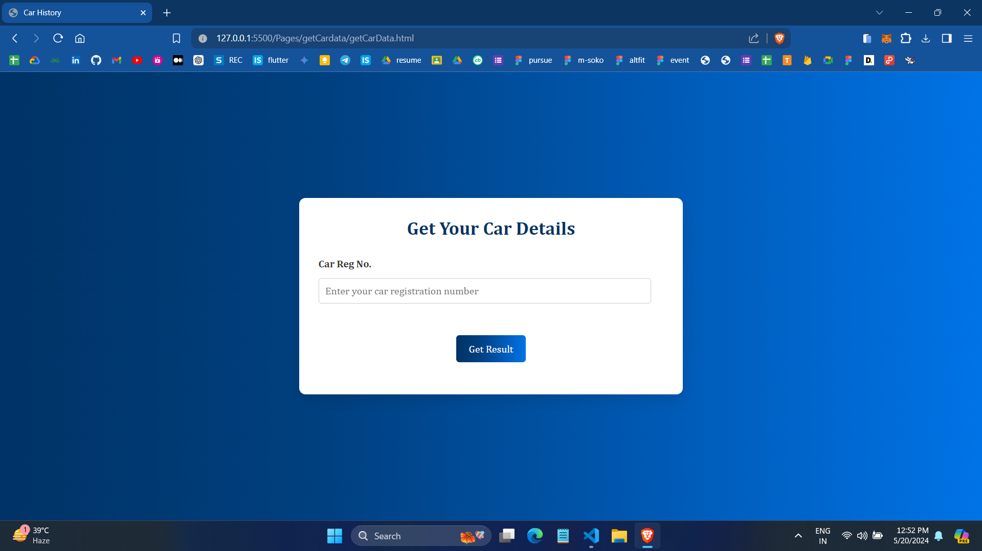
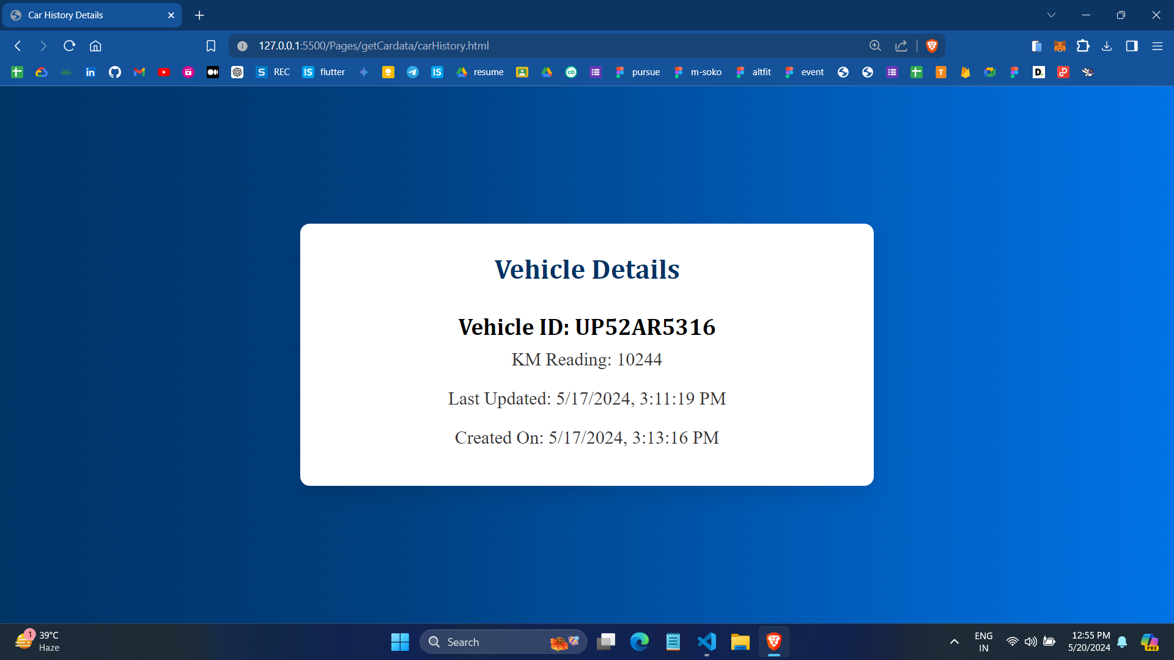
RESULT (continued…)
6
Fig 12: Vehicle Tracking Page
Fig 13: Vehicle Details Page

Slide 16
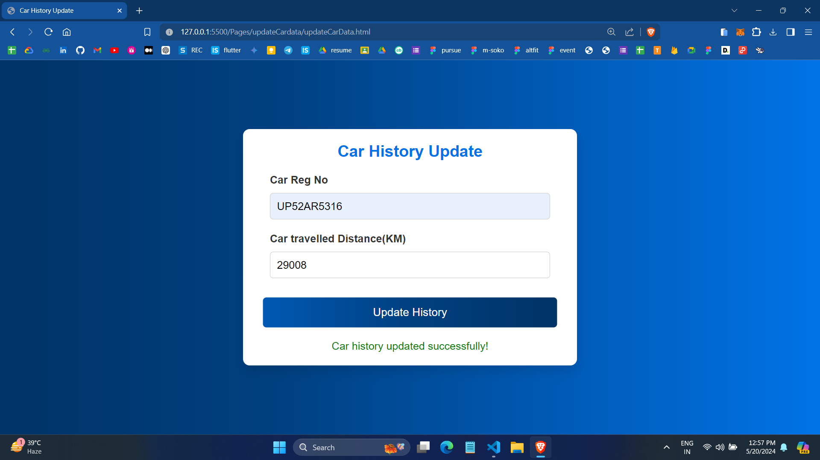
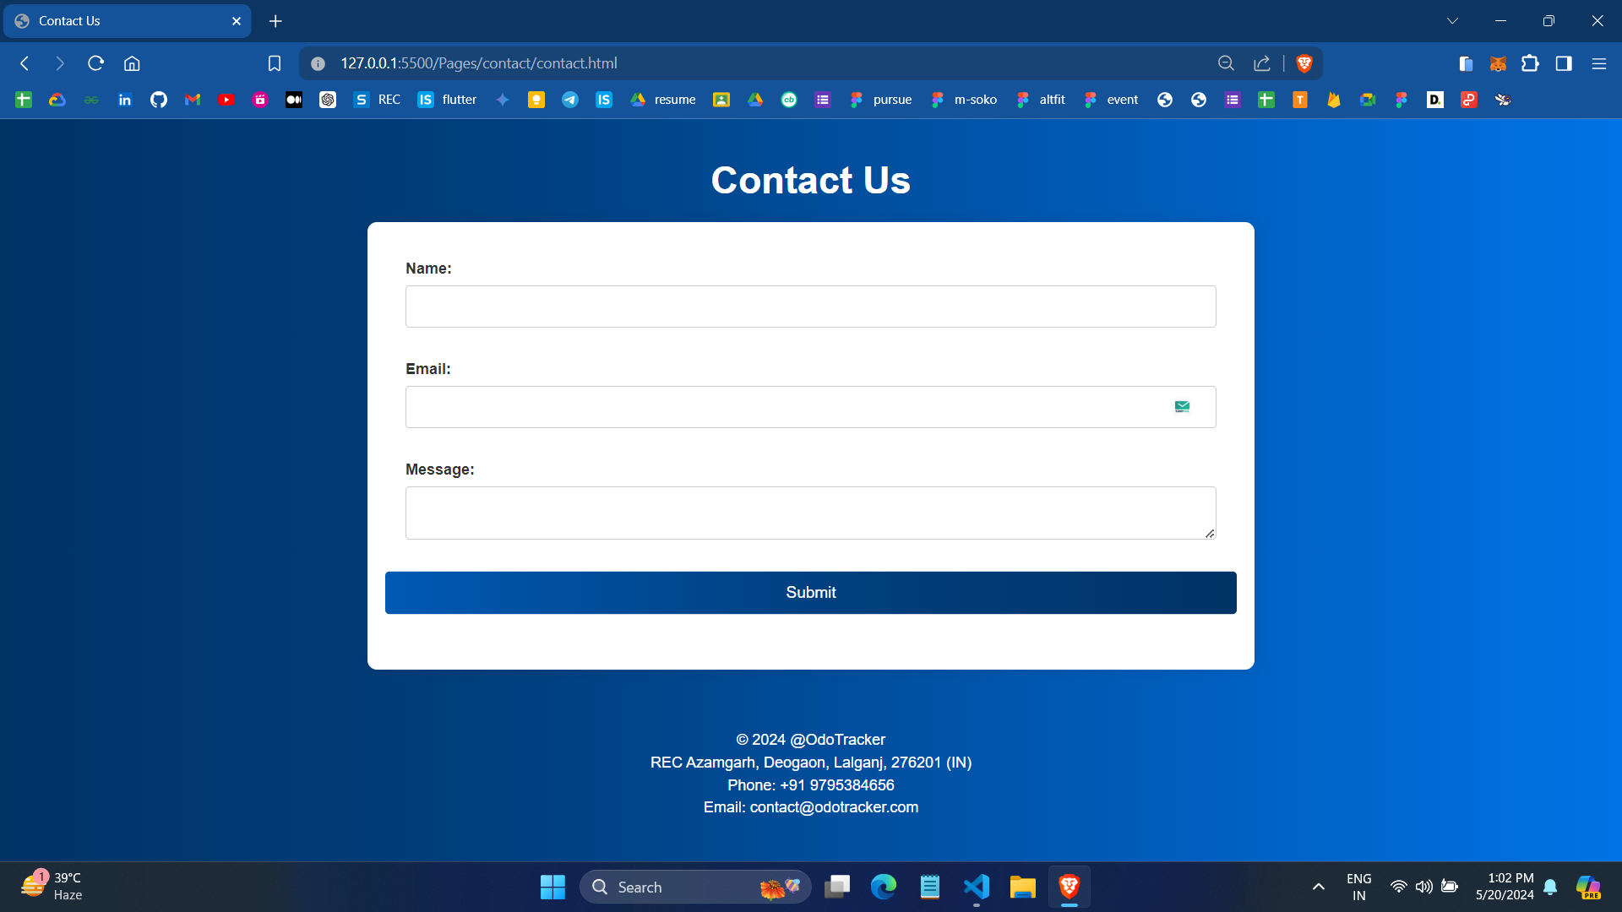
RESULT (continued…)
6
Fig 14: Vehicle History Update Page
Fig 15: Contact Us Page

Slide 17
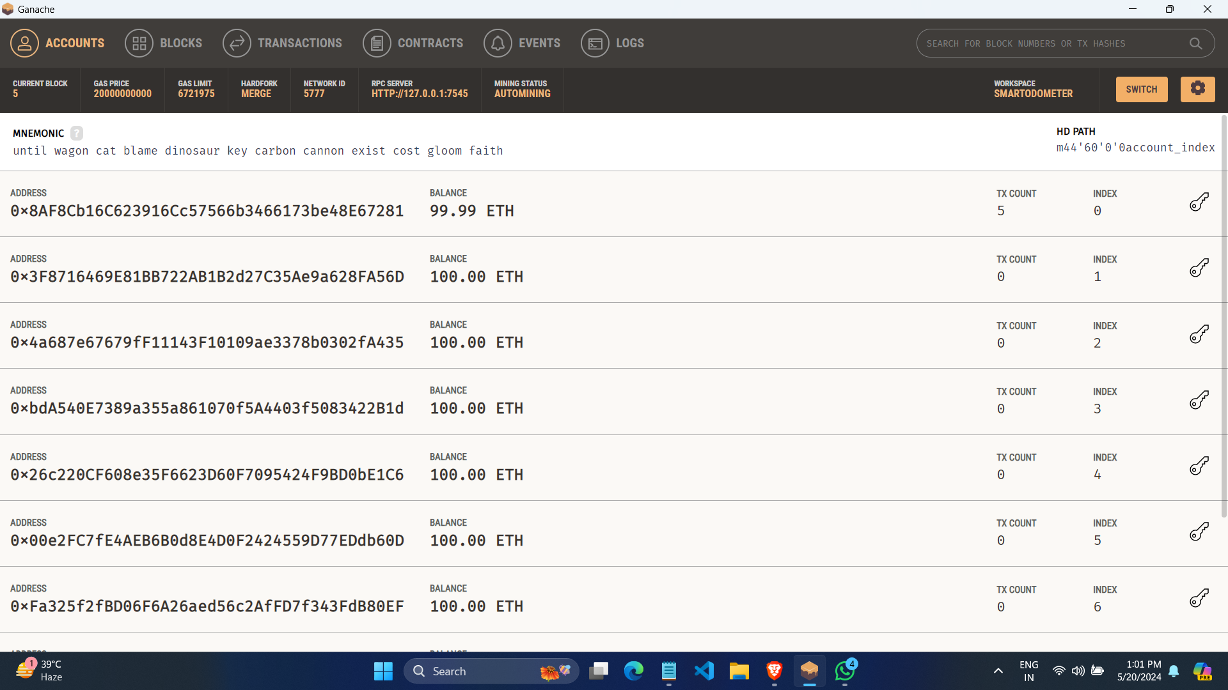
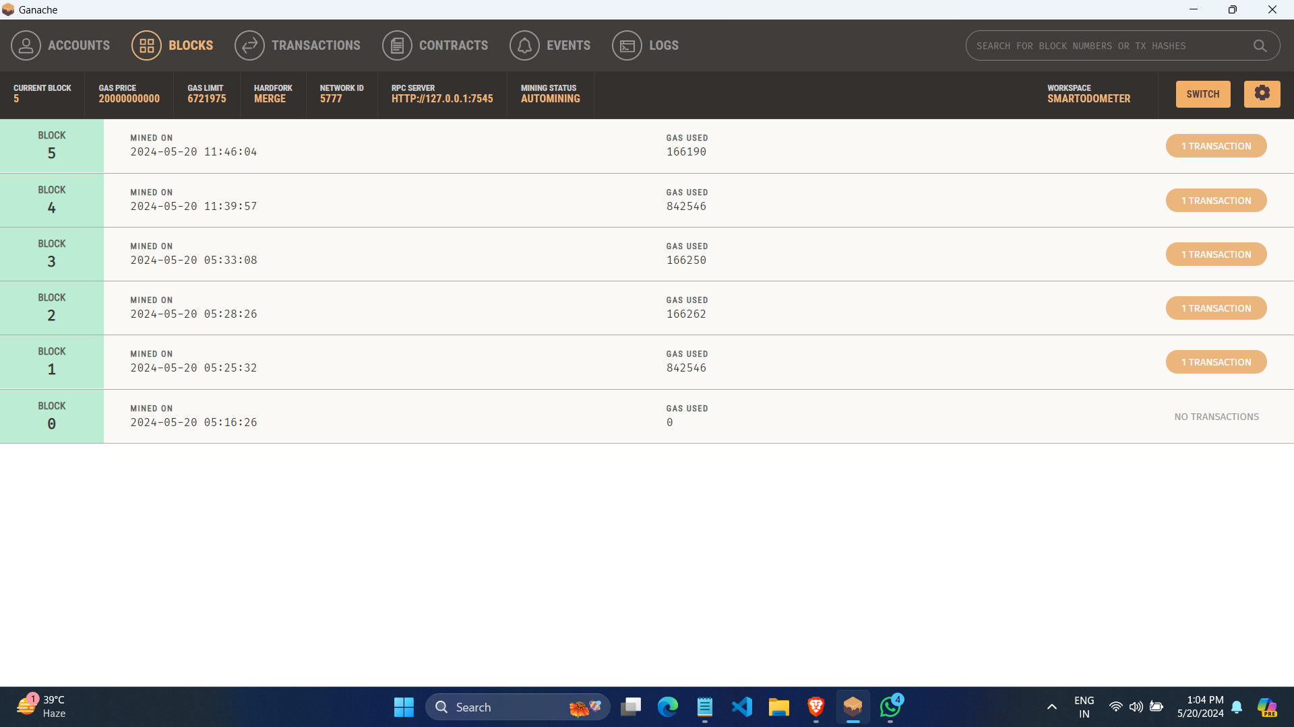
RESULT (continued…)
6
Fig 16: Ganache HomePage
Fig 17: Ganache Blocks

Slide 18
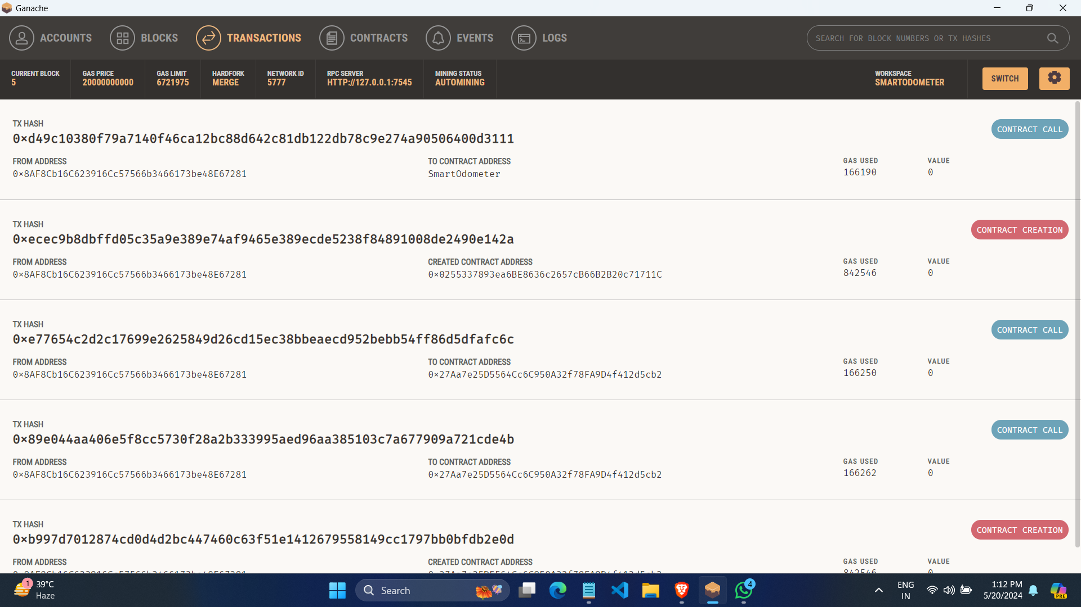
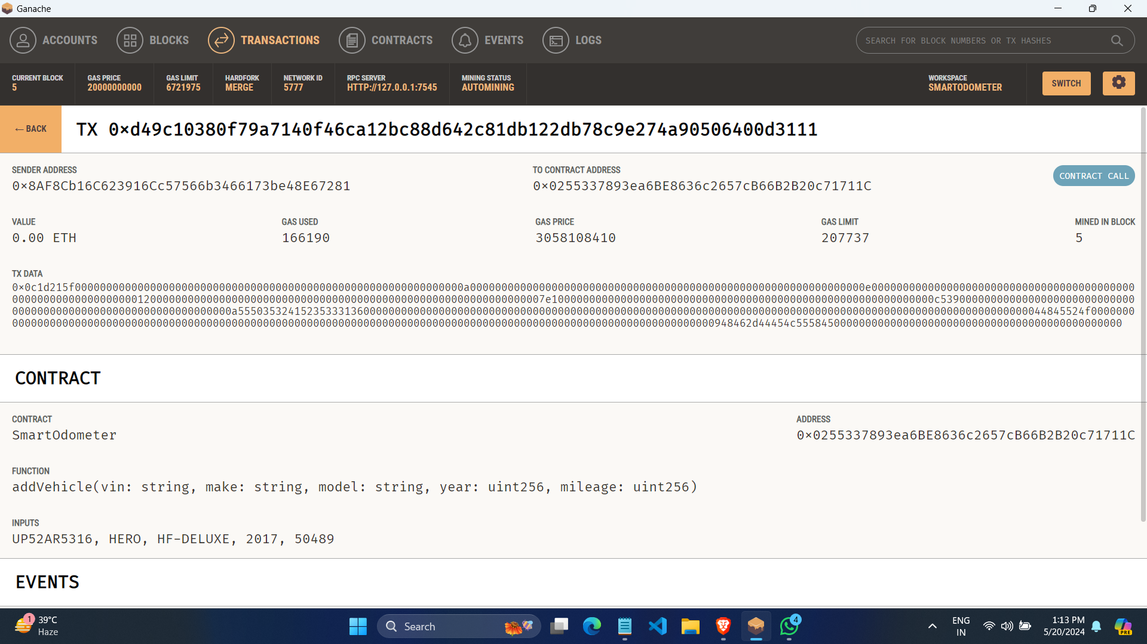
RESULT (continued…)
6
Fig 18: Ganache Transactions Page
Fig 19: Transaction Detail Page

Slide 19
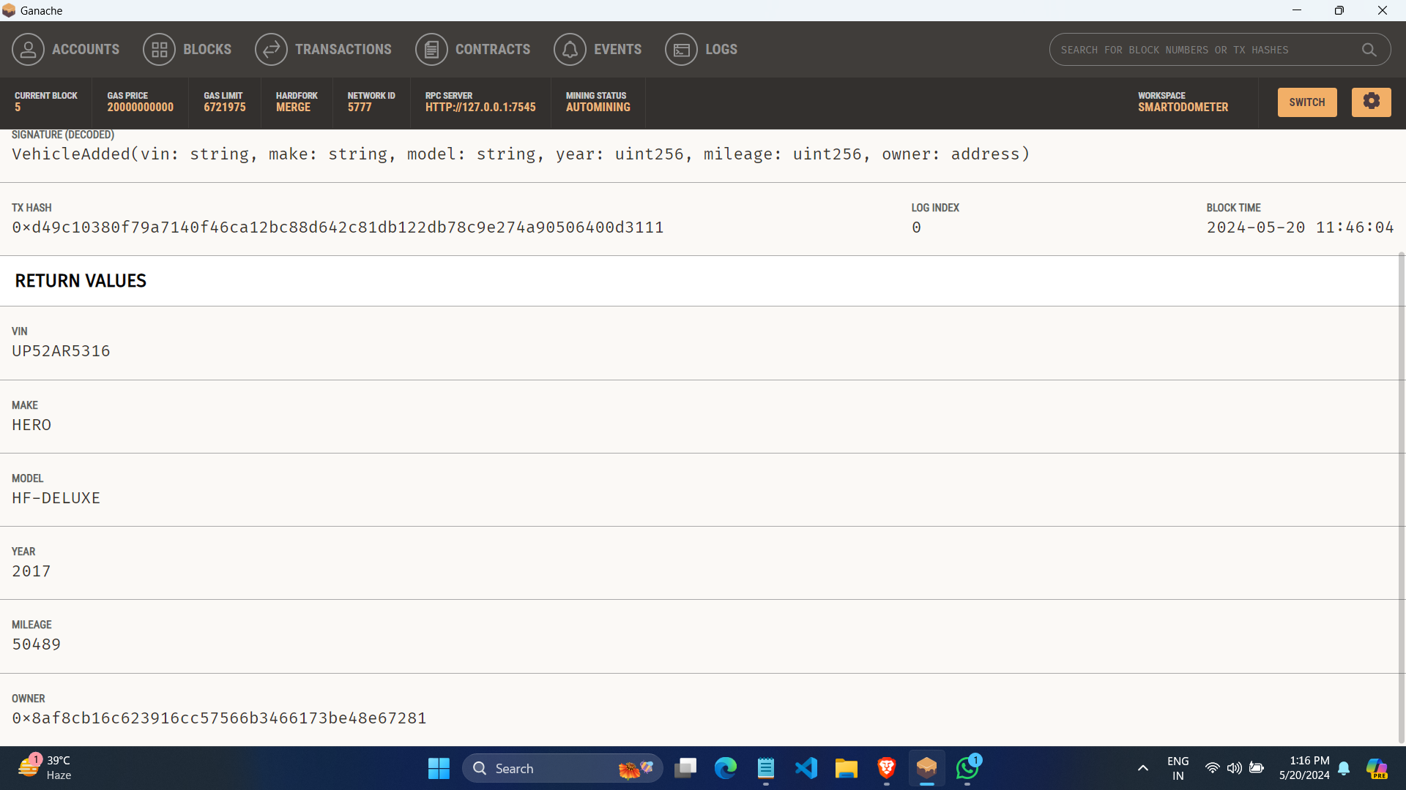
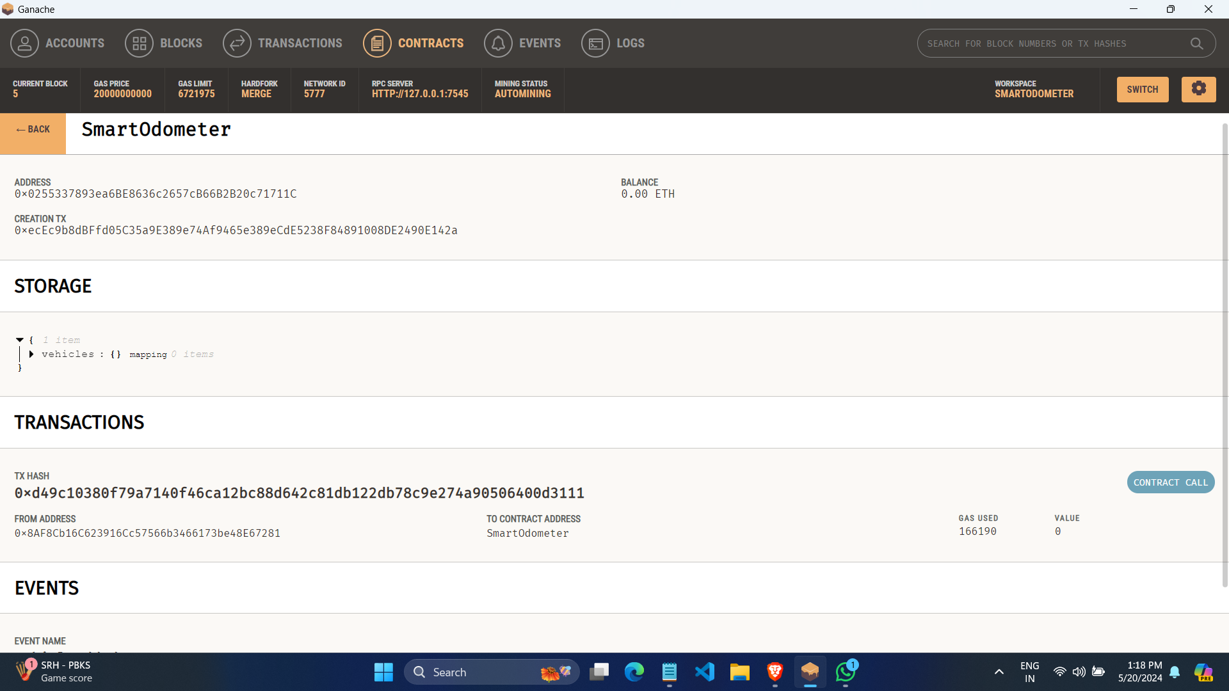
RESULT (continued…)
6
Fig 20: Ganache Vehicle Block Page
Fig 21: Ganache Smart Contract Detail Page

Slide 20
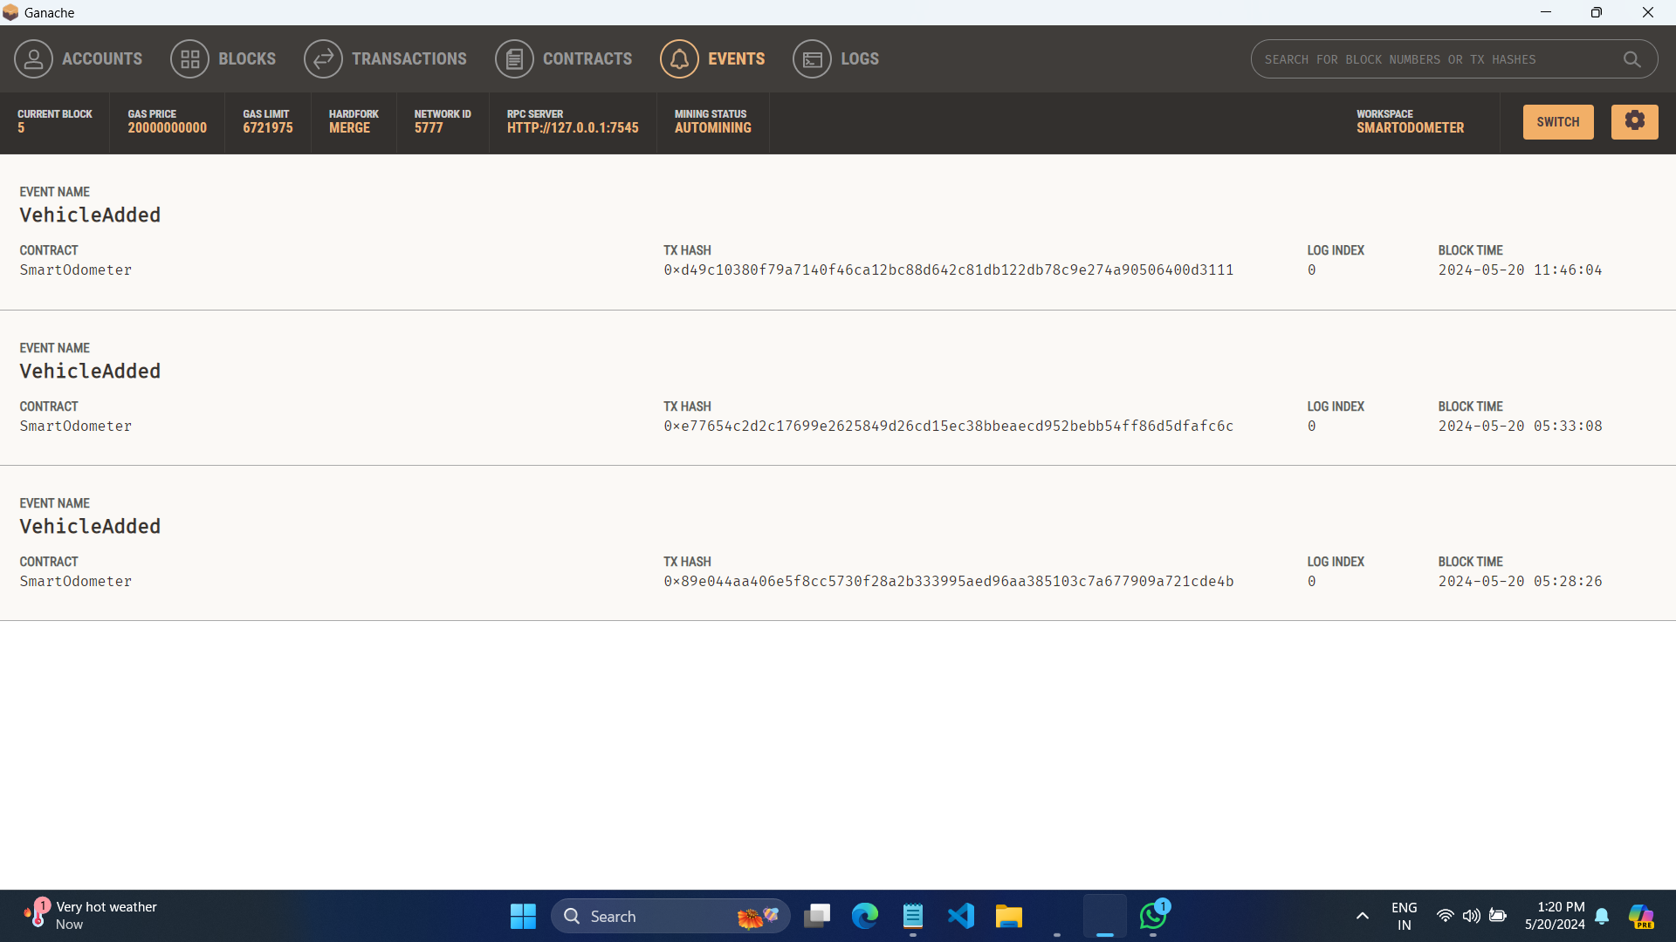
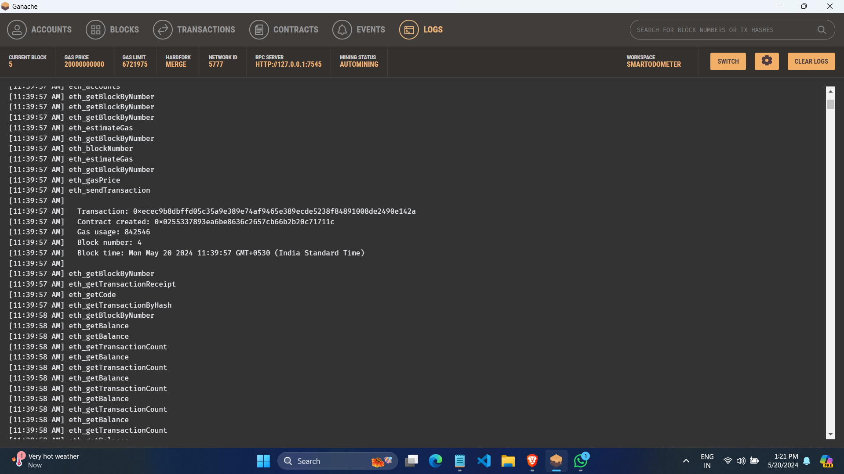
RESULT (continued…)
6
Fig 22: Ganache Events
Fig 23: Ganache Logs

Slide 21
Use Cases/Applications
6
Integration With IOT Devices.
Smart Contracts for Insurance Claim.
Tokenization of Vehicle ownership.
Data Analytics & Predictive Maintenance.
Supply Chain Transparency.
Integration with Government registries.
Blockchain Based Vehicle Identity.

Slide 22
CONCLUSION
6
The blockchain-based odometer system ensures that all vehicle data is transparent and accessible to all relevant parties, promoting trust.
Blockchain's immutable nature guarantees that odometer readings and vehicle data cannot be tampered with, preventing fraud and data manipulation.
By leveraging a decentralized network, the system eliminates the need for intermediaries, streamlining vehicle data management and reducing associated costs.
The system provides a permanent, reliable, and accessible record of vehicle history, aiding both buyers and sellers in making informed decisions.
Smart contracts automate the verification and update processes, ensuring efficiency and reducing manual intervention.
With secure and verifiable data, the system enhances confidence in vehicle transactions, benefiting the automotive market.

Slide 23
REFERENCES
6
A. Abhale, A. Pathare, A. Indapure, J. Wadekar, Dr. P. Shelke, “Blockchain Based used Vehicle Tracking System”, IJRASET, Volume 11, Issue V, May 2023.
C.L. Chen, Zhi. Zhu, M.Zong, W. T., C. Wu and H. Sun, “ A Secure and Traceable Vehicles and Parts System Based on Blockchain and Smart Contract.”, MDPI Journals Sensors Volume 22 Issue 18 , 2022
You-Ting Jiang, Hung-Min Sun, “A Blockchain-Based Vehicle Condition Recording System for Second-Hand Vehicle Market ”, Hindawi Wireless Communications and Mobile Computing Volume 2021, Article ID 6623251.
L. R. Abbade et al., "Blockchain Applied to Vehicular Odometers," in IEEE Network, vol. 34, no. 1, pp. 62-68, January/February 2020..

Slide 24
REFERENCES (continued…)
6
M. Liu, W. Luo, Y. Guo, and Lei Zhang, “Blockchain Technology Applied in Electric Vehicle Power Trading System.”, IEEE Access, 2019.
D. Kapoor, S. Gupta, A. Gupta, D. Grover, Silica Kole. “Prevention of Odometer Fraud Using Blockchain Technology.”, IJERCSE, Vol 5, Issue 11, November 2018.
Anoop A. A, A. S. Das, P. K. Sudesh N. N. Namboothiri. “ Secure Odometer: A Blockchain-based Solution. ”, IEEE, Kolkata Conference (CALCON), 2018.
M. C, Elgar F, Andreas B, Felix W., “Blockchain as a Privacy Enabler: An Odometer Fraud Prevention System. ”, ACM Adjunct, 2017.

Slide 25
THANK YOU !

